Slide 1
Computational Prediction of Boundaries of 3D Genomic Domains in Class Imbalance Settings
Spiro C. Stilianoudakis¹ (stilianoudasc@mymail.vcu.edu)
Mikhail G. Dozmorov¹ (mikhail.dozmorov@vcuhealth.org)
¹Dept. of Biostatistics, Virginia Commonwealth University, Richmond, VA, 23298, USA

Slide 2
Outline
Spatial organization of the human genome
Topologically associated domains (TADs)
Epigenomics
Predicting TAD Boundary Formation
Addressing data irregularities and characteristics
Establishing relationships between annotations and TADs
Identifying which epigenomic features are most predictive of TADs
Conclusions
Future Work

Slide 3
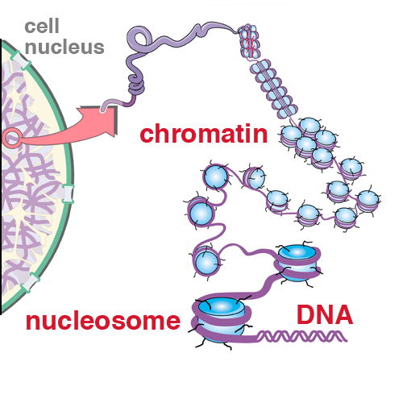
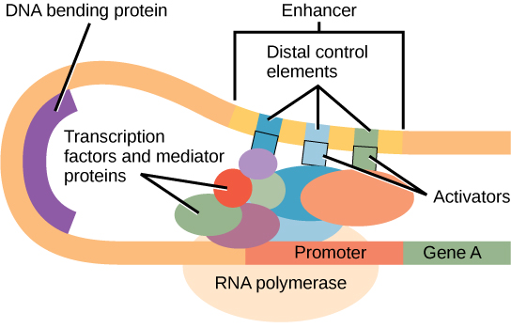
The Human Genome
The genome is composed of 22 pairs of autosomal chromosomes
Includes approximately 3 billion base pairs (A/T/C/G)
DNA must create compact loops to fit inside the nucleus of a cell
http://www.personal.psu.edu/sxt30/projects_chromatinenzymes.html
https://courses.lumenlearning.com/wm-nmbiology1/chapter/reading-eukaryotic-transcription-gene-regulation/

Slide 4
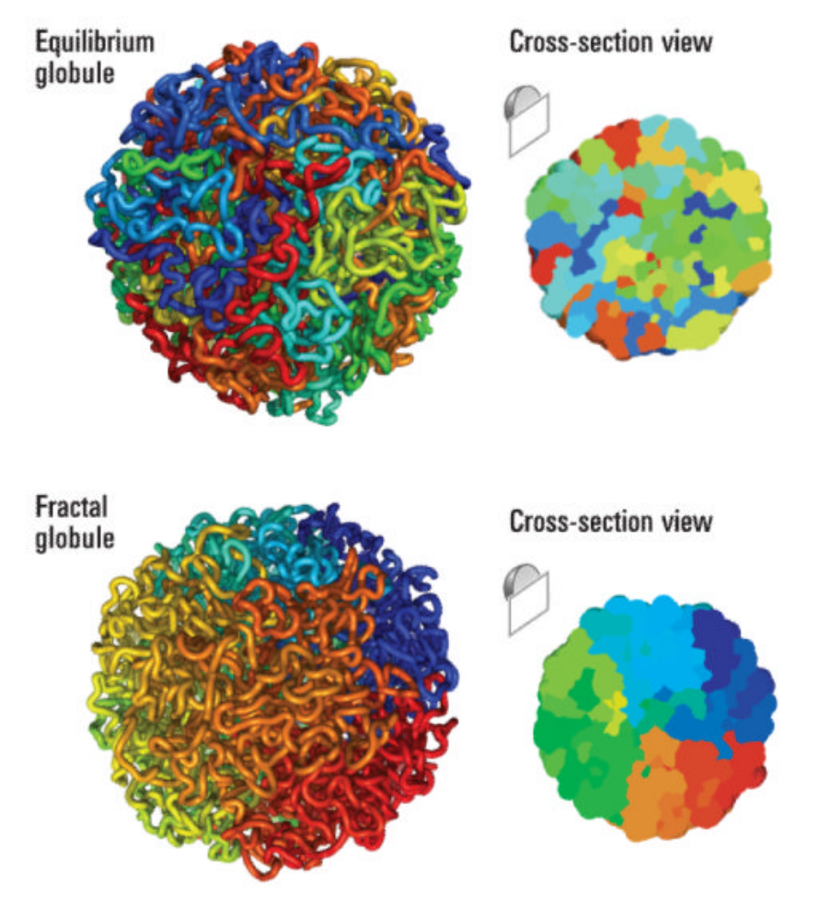
Chromosome conformation capture techniques
A set of molecular biology methods used to analyze the spatial organization of chromatin in a cell.
Quantify the number of interactions between genomic loci that are nearby in 3-D space, but may be separated by many nucleotides in the linear genome

Slide 5
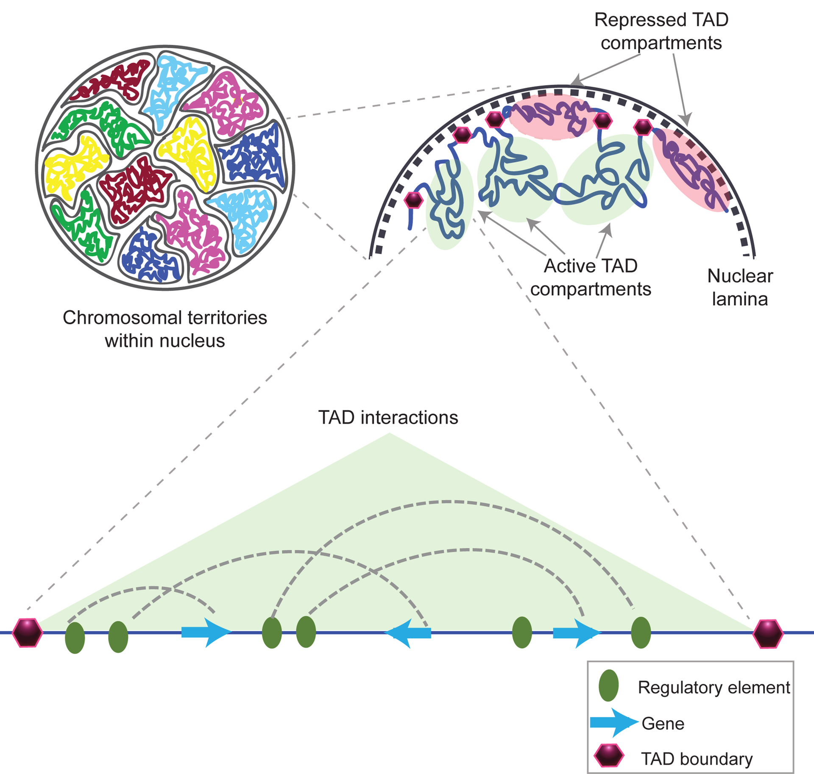
Topologically Associating Domains
Hi-C sequencing technologies have shown that the genome is tightly compacted into distinct compartments termed topologically associating domains (TADs)
The entire genome can be partitioned into two spatial compartments such that greater interaction occurs within each compartment rather than across compartments

Slide 6
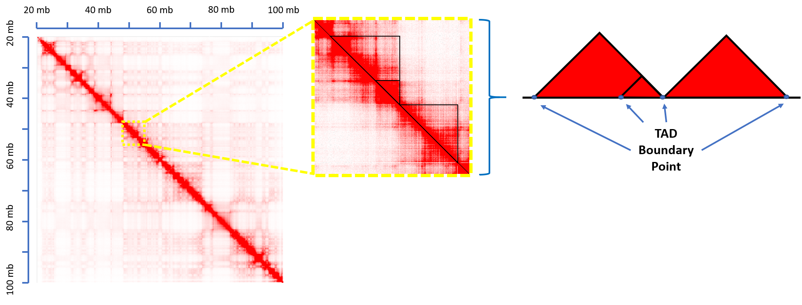
Topologically Associating Domains
TAD Calling Algorithms are used to delineate the regions on the linear genome that define a TAD.
The partitioning of the genome into TADs is hierarchical in nature
Many different algorithms have been proposed for identifying TADs from Hi-C data
http://aidenlab.org/juicebox/

Slide 7
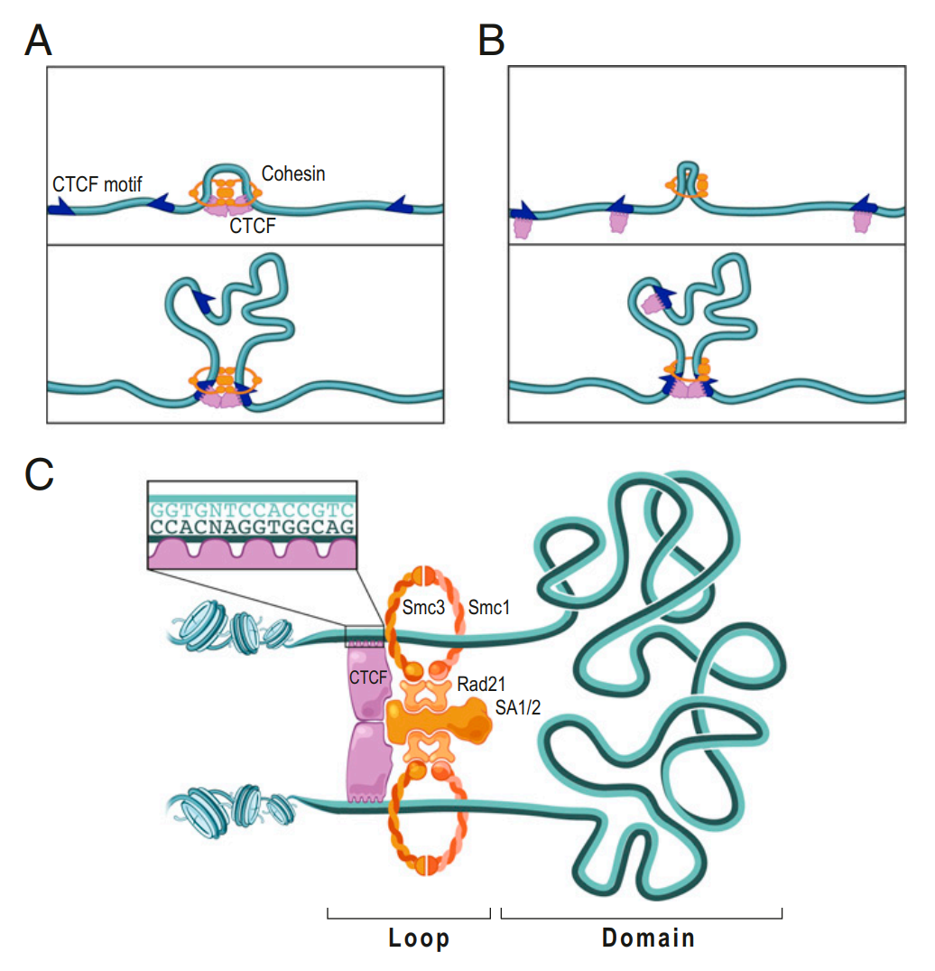
Characteristics of TADs
Evidence suggests that regulatory elements and genes tend to interact more frequently within the same TAD.
Boundaries of TADs may play a role in restricting the function of certain genomic elements such as enhancers, thereby impacting the transcription of genes.
Approximately 60-80% of TADs remain stable across cell types.
Studies have shown that changing the 3D structure of the DNA, causing disruptions in these domains, can lead to adverse outcomes and diseases like cancer.
It is unclear what the complete set of genomic-specific features are that correlate with TAD boundaries

Slide 8
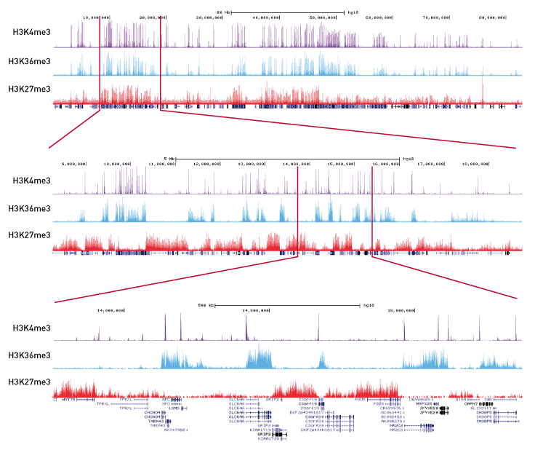
Relating TAD Boundaries to Epigenomic Functions
Epigenomics is the study of the complete set of molecular modifications that contribute to differential functionality in the genome
Protein coding genes only account for about 1% of the DNA sequences in the human genome.
They provide an opportunity to identify and understand how chromosomal structures act throughout the other 99% of the genome
Consists of chromatin states, histone modifications, transcription factor binding sites, DNAse I hypersensitive sites, etc.
Notes:
Combines chromatin immunoprecipitation (ChIP) with massively parallel DNA sequencing
Determines how transcription factors and other chromatin-associated proteins influence phenotype-affecting mechanisms

Slide 9
Using Epigenomic Annotations to Predict TAD Formation
We aim to create a classification algorithm that efficiently and correctly identifies the functional genomic elements most predictive of the formation of TAD boundaries
Create and ensemble framework in which we answer the following questions:
How severe is class imbalance?
What type of predictors improve model performance?
Which functional genomic elements are most predictive of TAD boundaries?

Slide 10
Domain Data Source
Publicly available Replicate Hi-C data was obtained for the GM12878 and K562 cell lines from Rao et al. 2014 (GEO GSE63525)
The autosomal genomic coordinates (GRCh37/hg19 human genome assembly) of TAD boundaries were obtained from data at 10 kb, 25 kb, 50 kb, and 100 kb resolution using the Arrowhead algorithm (developed by Rao et. al (2014))

Slide 11
Genomic Annotation Data Source
Genomic annotation data were obtained from the UCSC Genome Browser Database
Consisted of over a hundred different combinations of the following cell type-specfic:
Chromatin states
Histone marks
Transcription factor binding sites
DNAse Hypersensitive Sites

Slide 12
Model Construction
Detail outline of model construction here

Slide 13
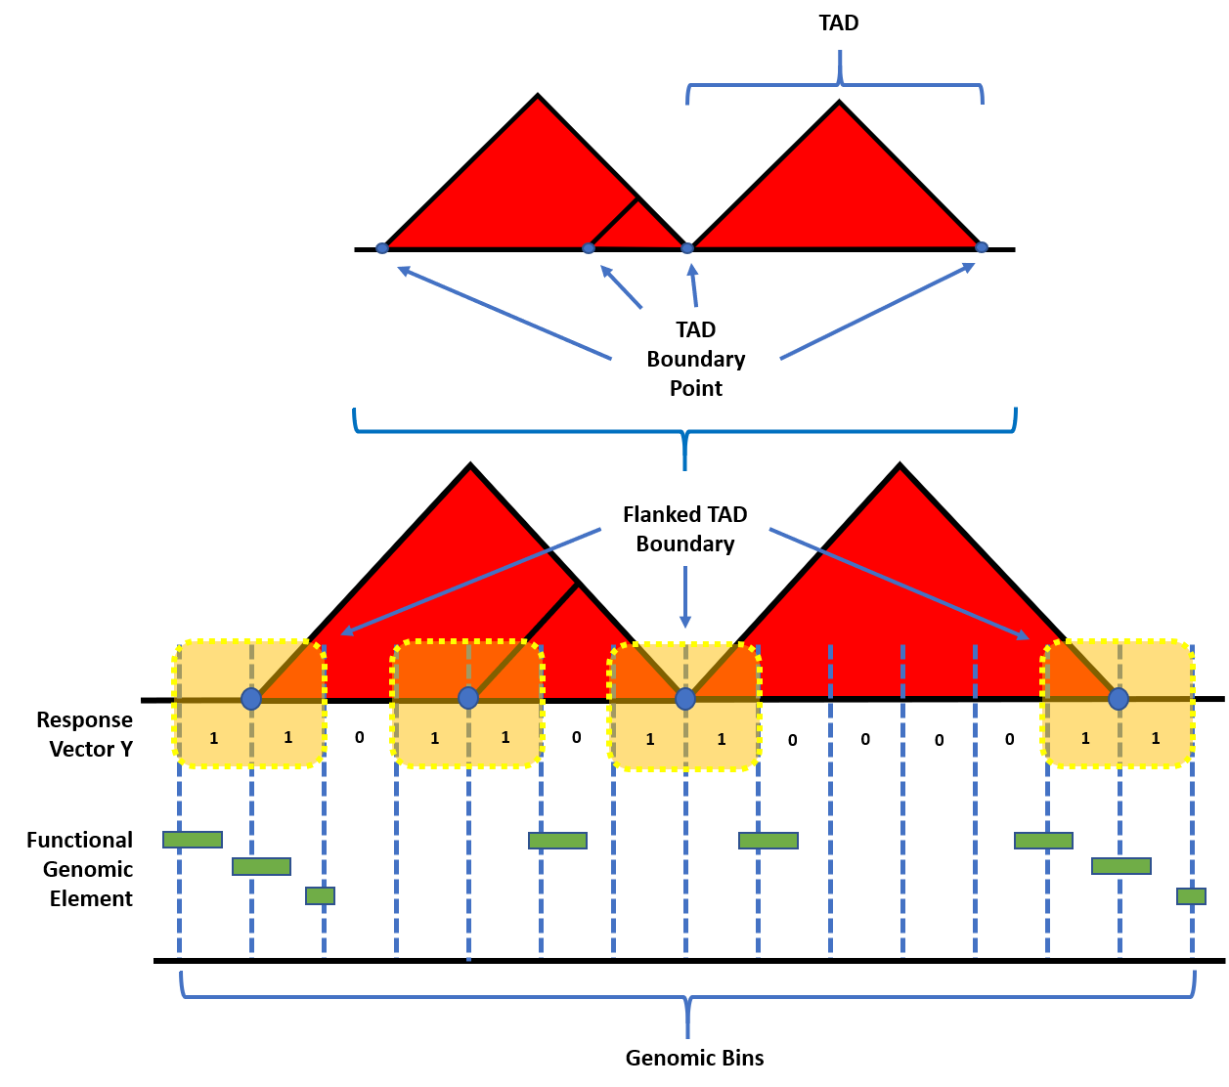
Model Construction: Establishing the response
Identified TAD boundaries were represented by their starting and ending coordinates in the linear genome.
The genomic coordinates of all TADs were concatenated, sorted, and unique TAD boundary points were obtained.
In order to accommodate for the uncertainty in exact boundary location, the boundary points were flanked on both sides by the size of the resolution of the corresponding contact matrix.

Slide 14
Model Construction: Establishing the response
The genome was binned into equally sized intervals defined by the data resolution for the corresponding contact matrix.
A genomic bin was labeled as having a TAD boundary within it (Y=1) if it overlapped with a particular flanked boundary. Otherwise, the bin was labeled as not containing a boundary (Y=0).

Slide 15
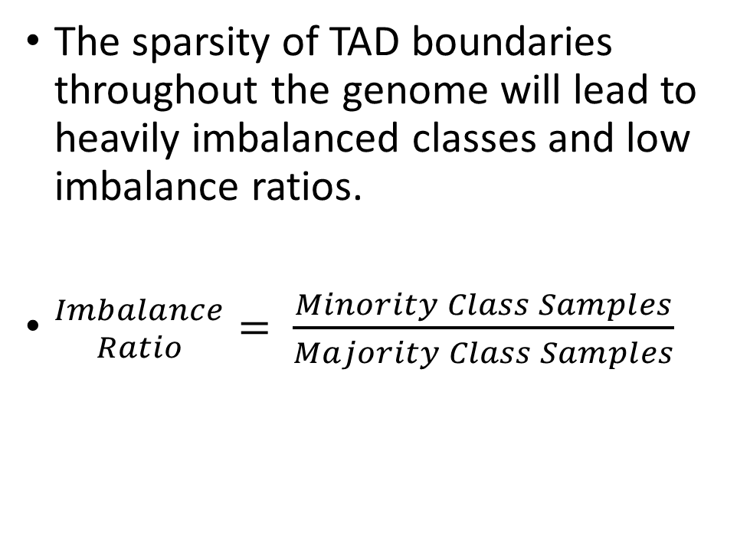
Model Construction: Establishing the response
The sparsity of TAD boundaries throughout the genome will lead to heavily imbalanced classes and low imbalance ratios.
${Imbalance \atop Ratio}= \frac{Minority Class Samples}{Majority Class Samples}$

Slide 16
Model Construction: Feature engineering
Using the sets of genomic annotations, we created three types of predictors that were used as features for subsequent models to analyze their respective spatial relationship with TAD boundaries

Slide 17
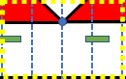
Model Construction: Predictor Types
Overlap Counts (OC):
The total number of instances where a genomic bin overlapped with regions assigned to genomic annotations (features). In the case of no overlaps, the value was set to 0.
1
0
1
1

Slide 18
Model Construction: Predictor Types
Overlap Percents (OP):
The percent of overlap between the width of the region assigned to a genomic annotation and the total width of the bin (in basepairs). The percent was then calculated by dividing the feature width by the bin width.
Feature Width
Bin Width

Slide 19
Model Construction: Predictor Types
Log₂ Distance:
The log₂ of the distance (in basepairs; refered to hereafter simply as distance), from the center of the bin to the center of the nearest region defined by a specific genomic annotation.
D₁
D₂
D₃
D₄

Slide 20
Model Construction: Re-sampling Techniques
In order to assess the influence of imbalanced classes, we then evaluated four re-sampling techniques (in addition to no re-sampling), composed of data from each predictor type.
No Sampling: All of the data points from the majority and minority class of the training set were used.

Slide 21
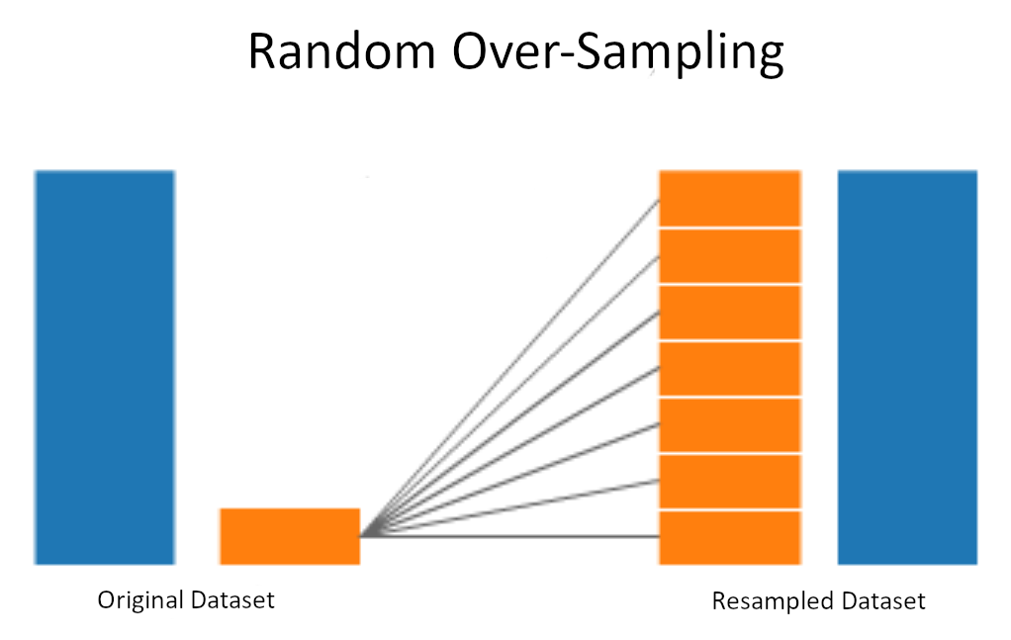
Model Construction: Re-sampling Techniques
Random Over-Sampling (ROS): All of the majority classes from the training set were used. Sampling with replacement was used to obtain the same number of the minority classes.

Slide 22
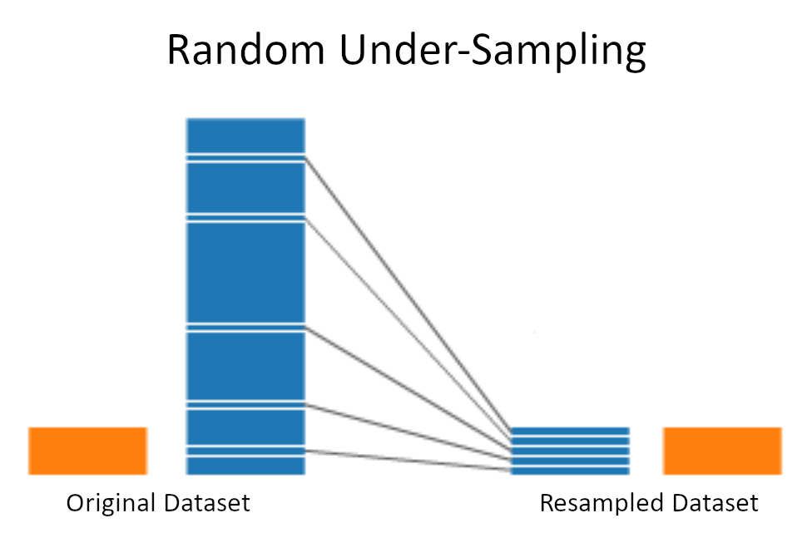
Model Construction: Re-sampling Techniques
Random Under-Sampling (RUS): All of the minority classes from the training set were used. Sampling without replacement was used to obtain the same number of the majority classes.

Slide 23
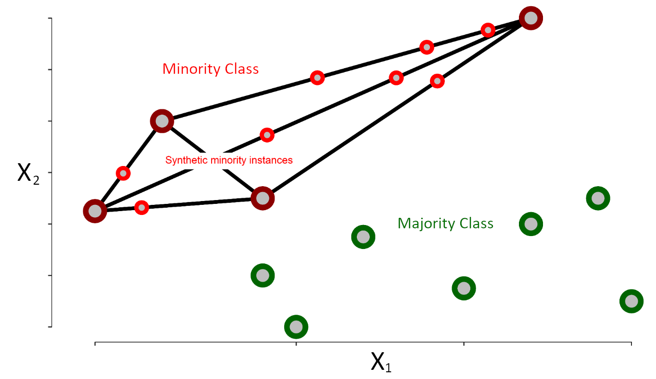
Model Construction: Re-sampling Techniques
SMOTE (Synthetic Minority Over-Sampling Technique): Incorporates both random under- and over-sampling. Under-sampling is performed without replacement from the majority class, while over-sampling is performed by creating new synthetic observations using the minority class. The DMwR R package was used to perform SMOTE (version 0.4.1).

Slide 24
Model Construction: Feature Reduction
To reduce model complexity and improve computational efficiency an Elastic-Net regularization algorithm was performed
Using a combination of the L₁ and L₂ norm penalties suitably reduces aberrant noise in the model while also maintaining possibly colocalized genomic features near TAD boundaries
10-fold cross-validation was used to tune the parameters that controlled the penalty terms

Slide 25
Model Construction: Classification
Random forest classification models were performed to predict TAD boundary formation using genomic annotations
To reduce bias due to random dataset generation, 10-fold cross validation was used to tune the number of features to consider at each node and the number of ensemble trees to aggregate.

Slide 26
Model Construction: Measuring Performance
Once the model was implemented, it was assessed using the test set, and performance metrics were recorded.
Commonly used measures of model performance for binary classifiers include threshold-free metrics like the area under the receiver operating curve (AUROC), and other threshold-specific metrics like accuracy, sensitivity, and specificity.
Problems arise when using such measures in the event of imbalanced classes.
Better measures to consider are composite metrics involving both precision and recall together because they soften the influence of a model's ability to correctly classify majority classes and yield more dependable and interpretable results.

Slide 27
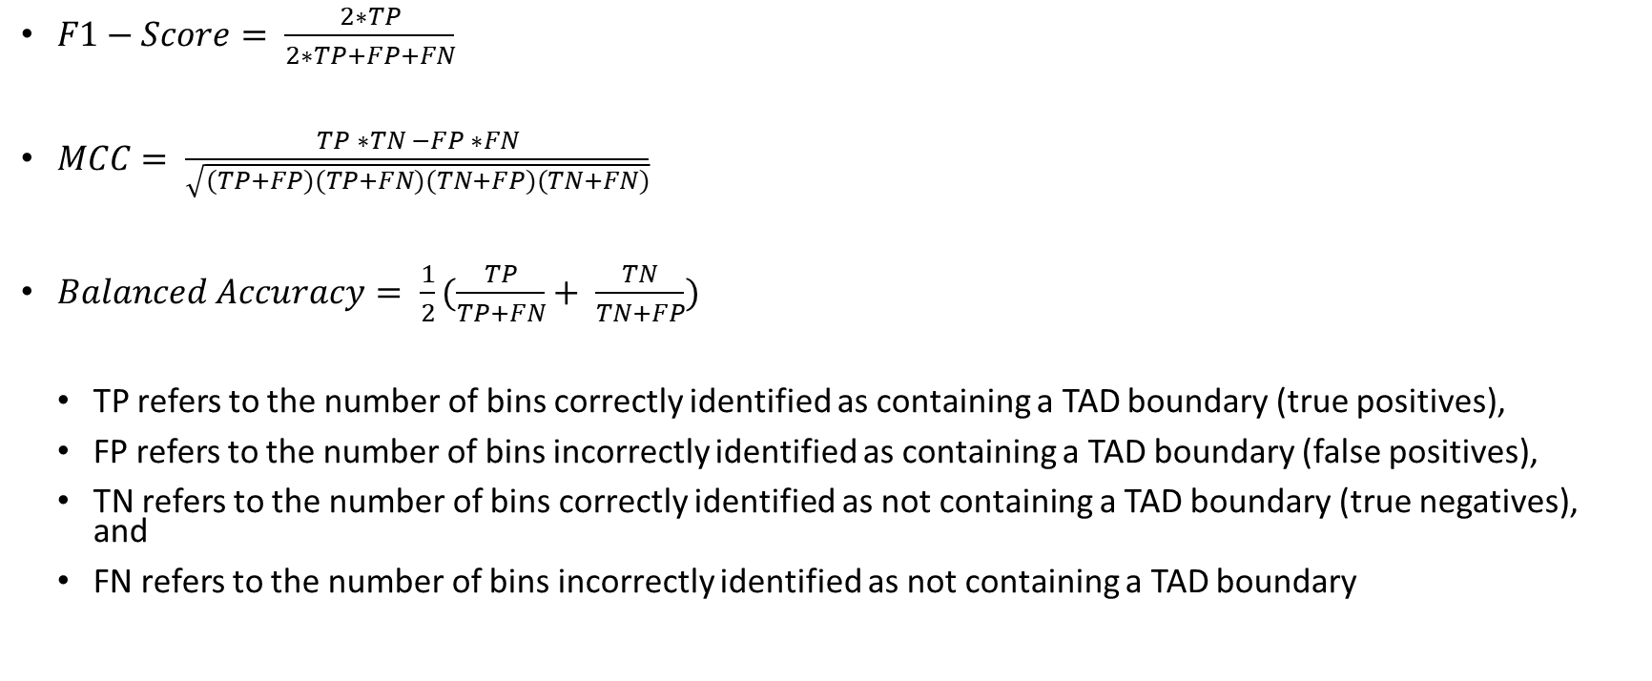
Model Construction: Performance Metrics
$F1−Score= \frac{2∗TP}{2∗TP+FP+FN}$
$MCC= \frac{TP ∗TN −FP ∗FN}{\sqrt{(TP+FP)(TP+FN)(TN+FP)(TN+FN)}}$
$Balanced Accuracy= \frac{1}{2}(\frac{TP}{TP+FN}+ \frac{TN}{TN+FP})$
TP refers to the number of bins correctly identified as containing a TAD boundary (true positives),
FP refers to the number of bins incorrectly identified as containing a TAD boundary (false positives),
TN refers to the number of bins correctly identified as not containing a TAD boundary (true negatives), and
FN refers to the number of bins incorrectly identified as not containing a TAD boundary

Slide 28
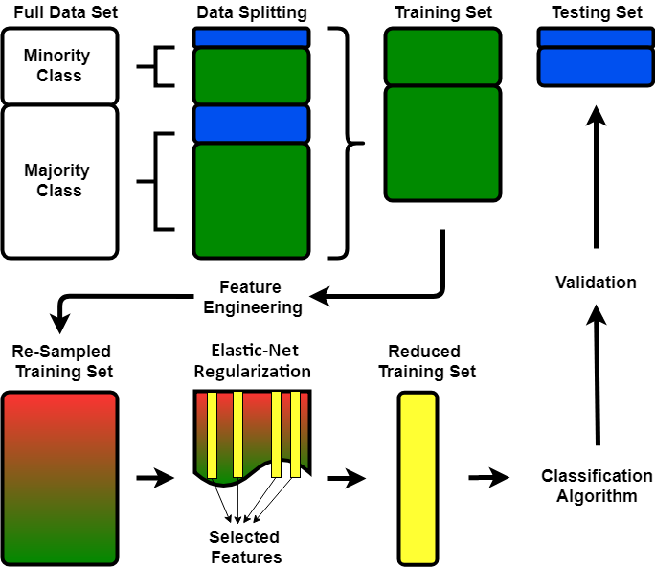
Forming an Ensemble Framework
We evaluated and compared multiple random forest classification algorithms built on domain data extracted from Hi-C datasets for 2 cell lines:
C = {GM12878, K562}
At 4 different data resolutions:
R = {10 kb, 25 kb, 50 kb, 100 kb}
For each classifier, we combined three predictor types:
P = {OC, OP, Distance}
With 4 class balancing techniques:
B = {None, RUS, ROS, SMOTE}.
A system produced from the ensemble framework was defined as:
E = {c, r, p, b},
where c \in C, R \in R, p \in P, and b \in B.
Letting |X| denote the cardinality of each set, we evaluated |C| x |R| x |P| x |B| different ensemble systems, totaling 96 separate models.

Slide 29
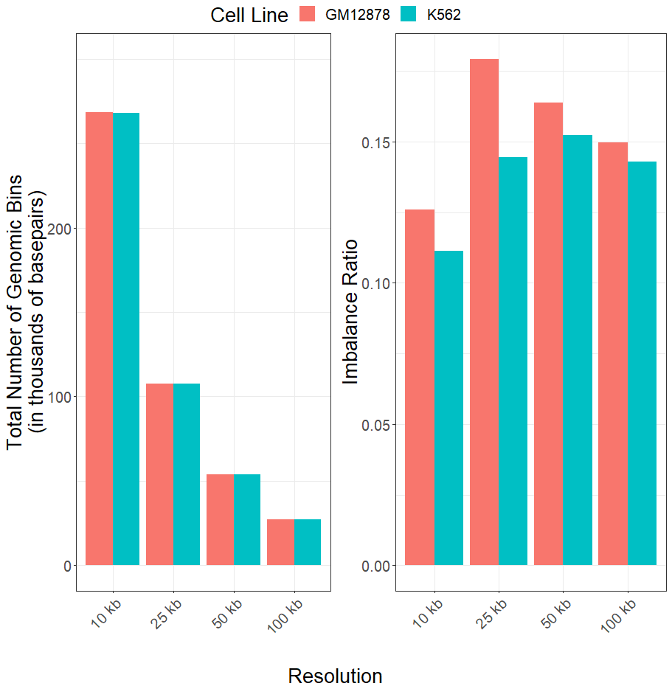
Imbalance Ratios Remained Severe & Consistent Across Resolutions
We first examined the class imbalance of the different data resolutions for each cell line.
The total number of genomic bins decreased as resolution increased
Average imbalance ratios were 0.154 (SD=0.022) and 0.137 (SD=0.0181) across resolutions for the GM12878 and K562 cell lines respectively

Slide 30
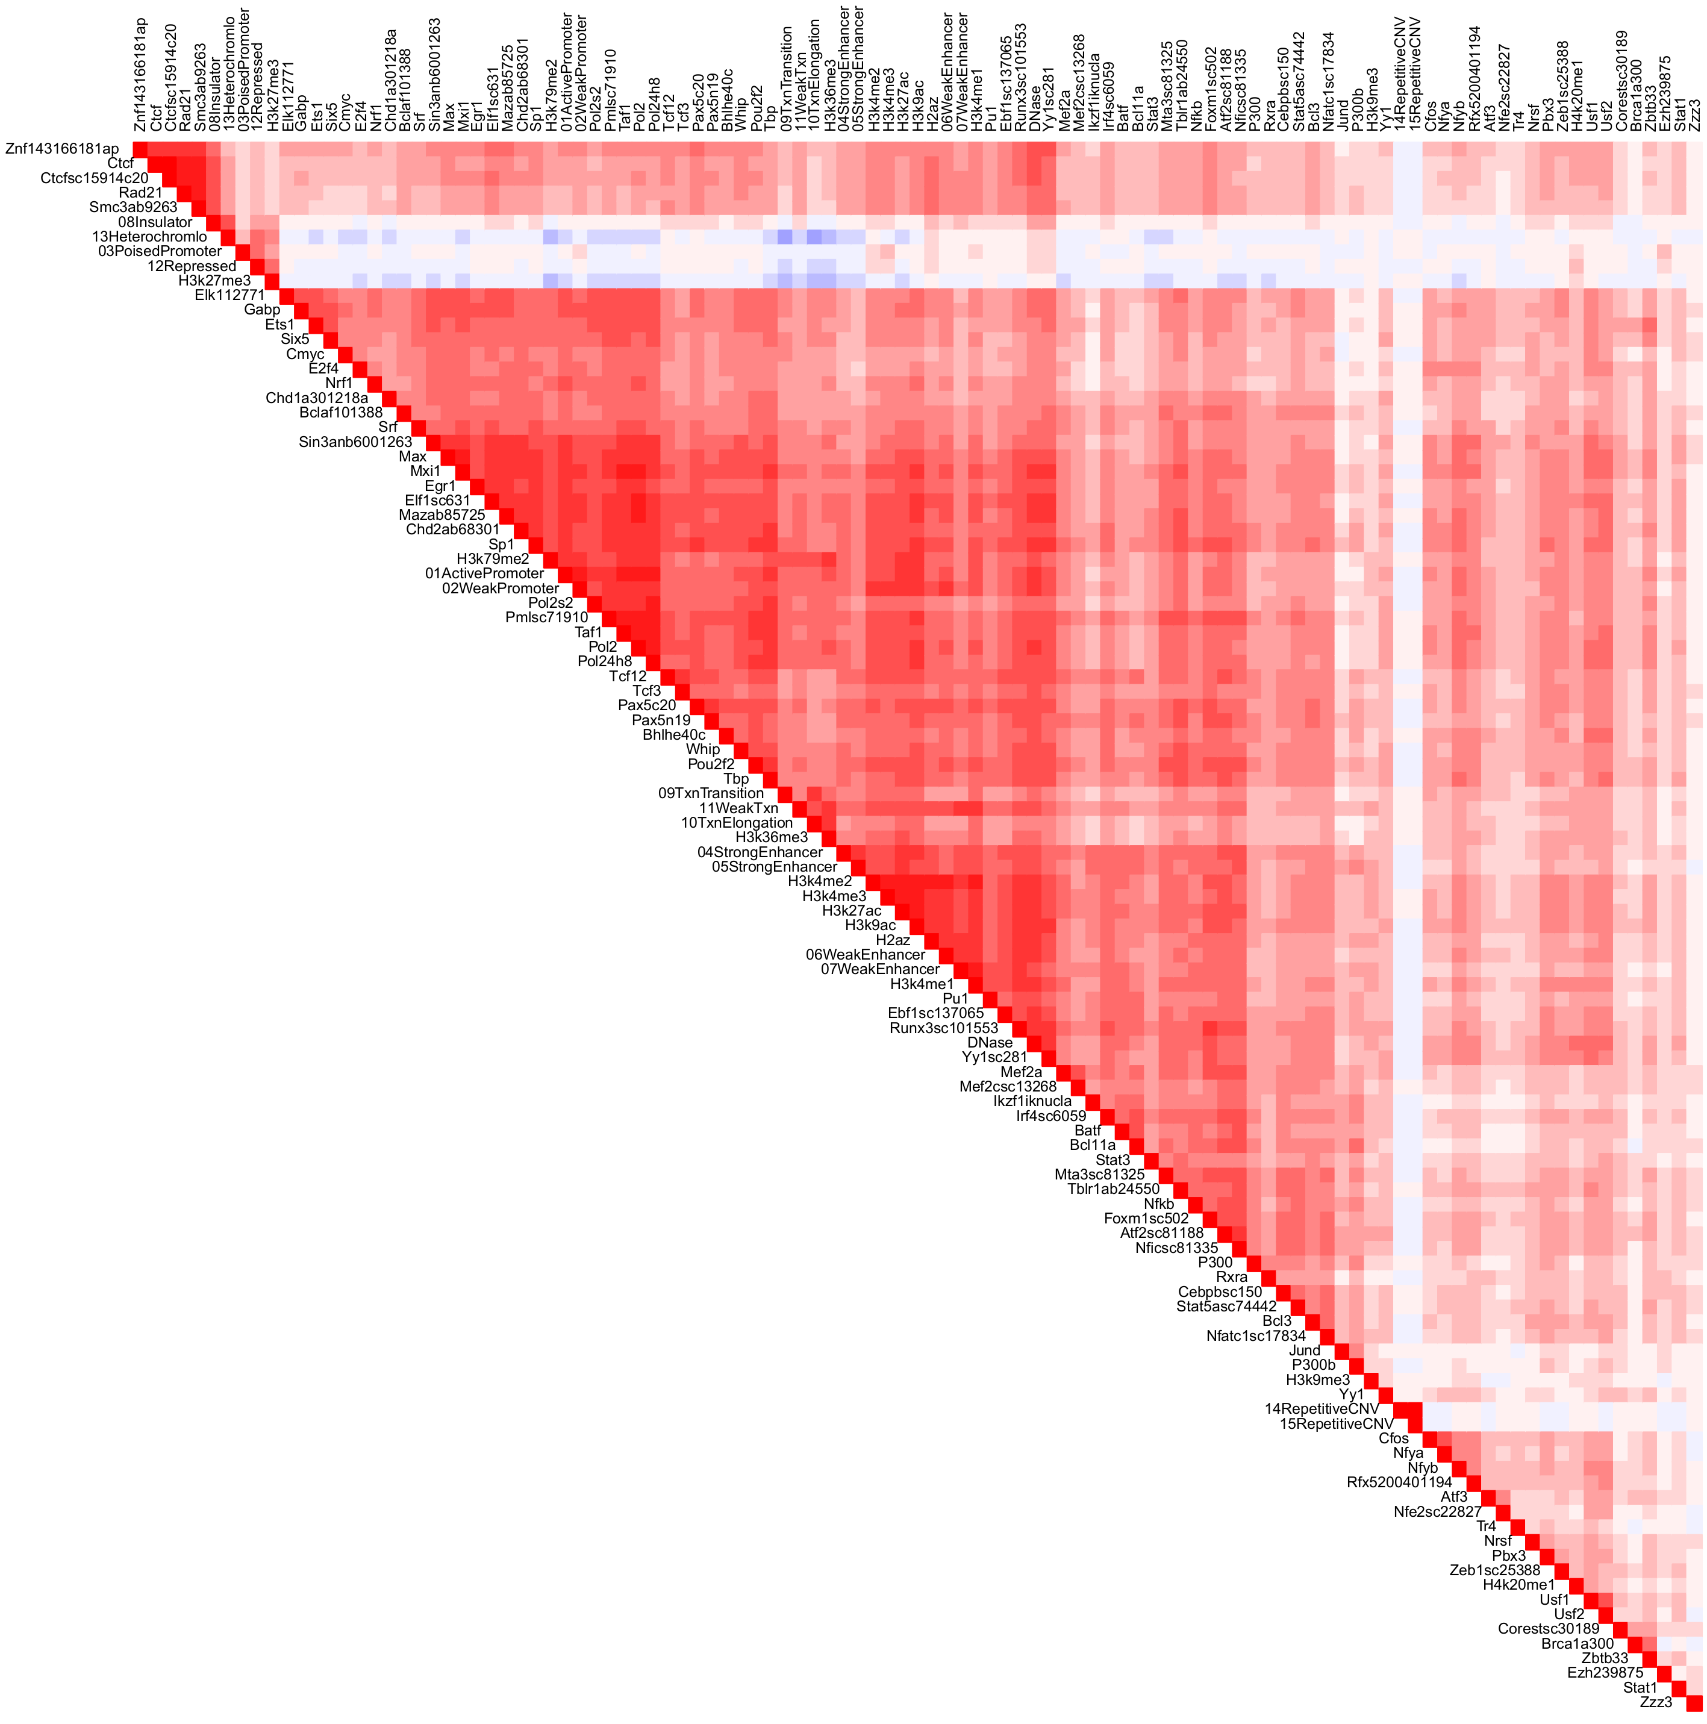
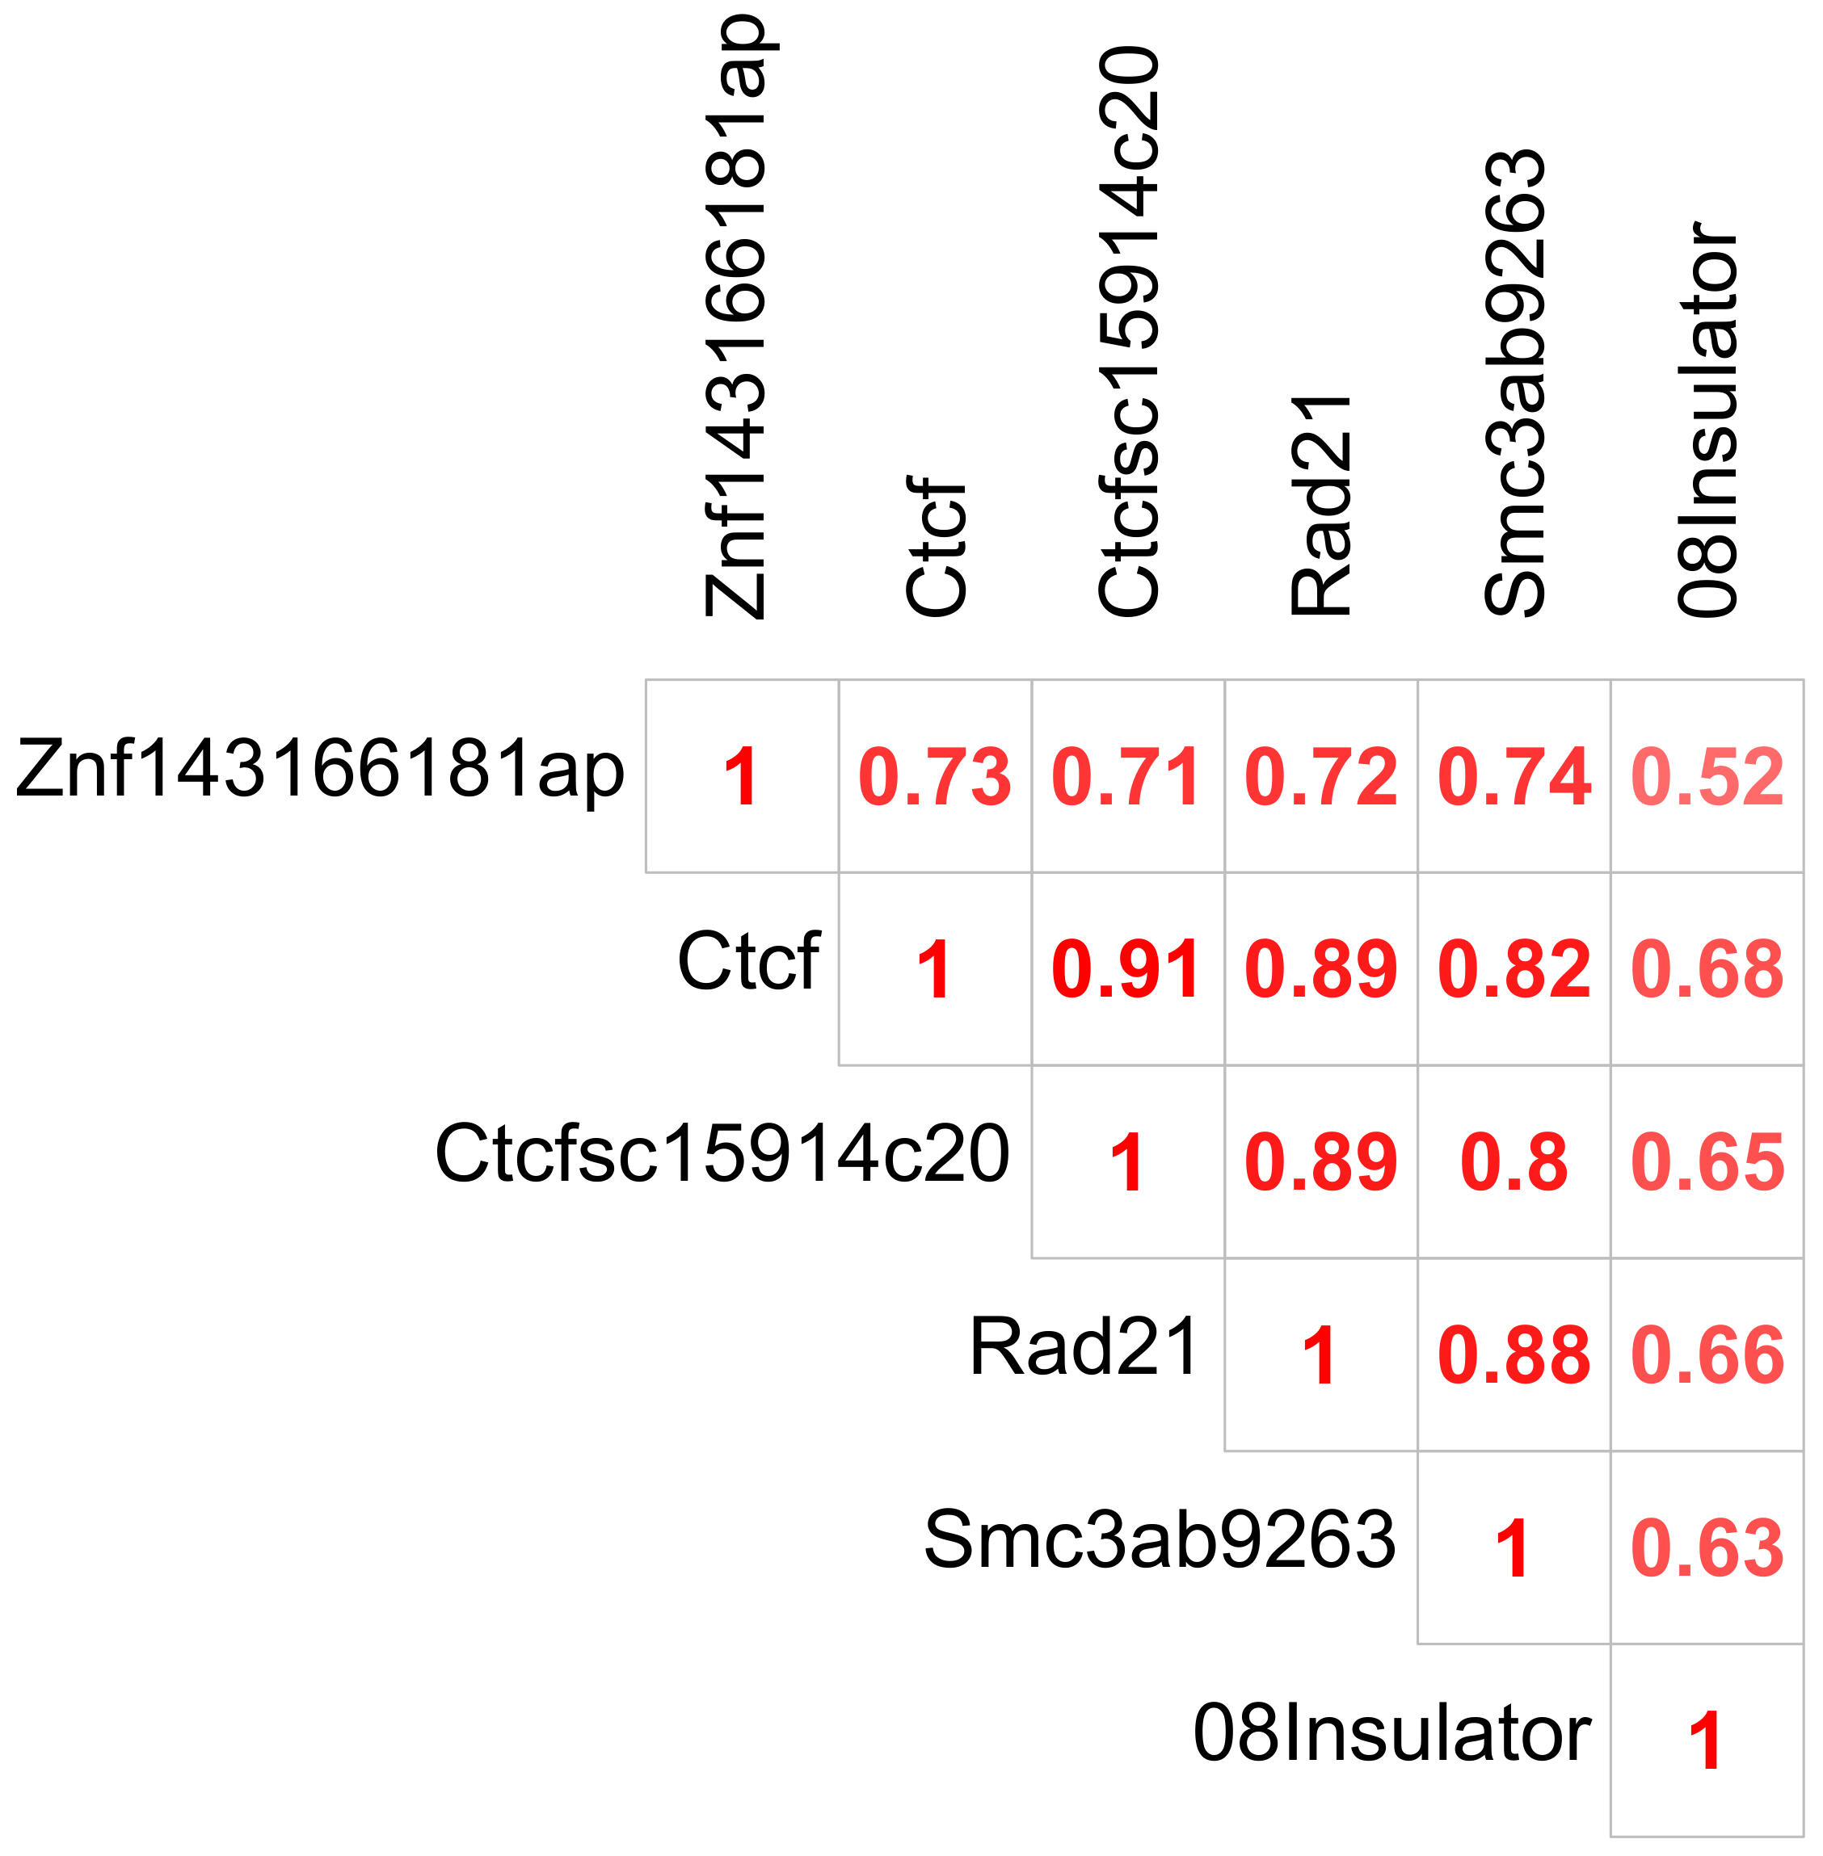
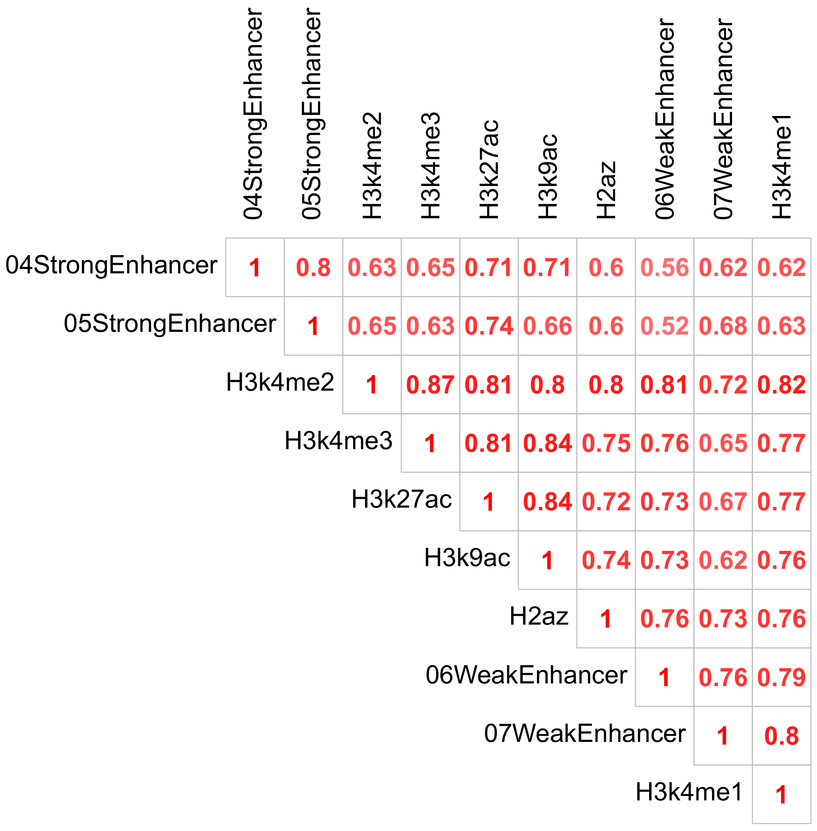
High Correlations Imply Colocalized Annotations Around TAD Boundaries

Slide 31
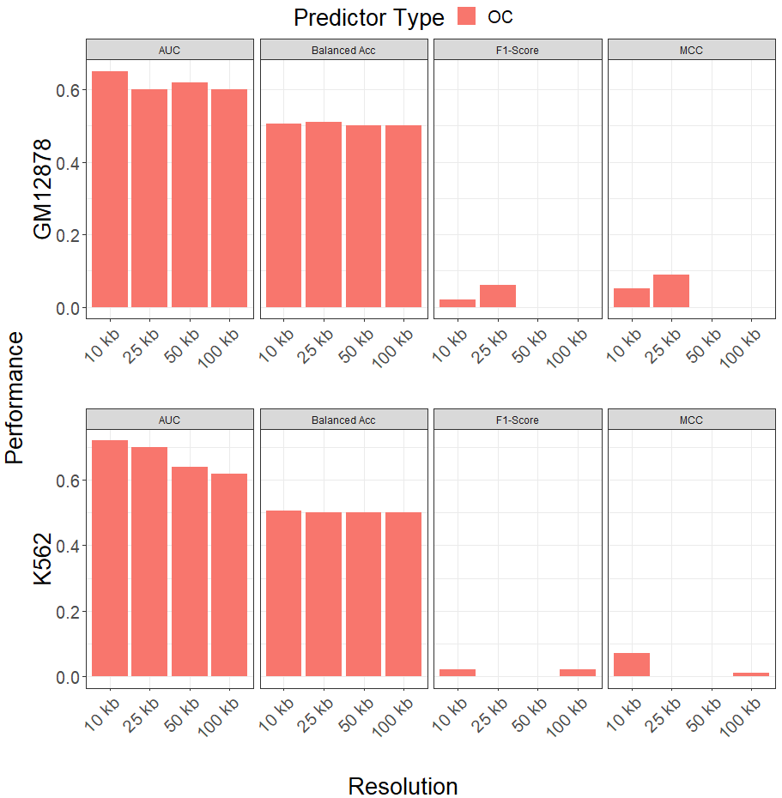
Class Imbalance Severely Impacts Model Performance Across Resolutions
We first evaluated model performances using count overlap predictor types without re-sampling
Conventional metrics are unable to accurately describe poor performance
Some models at higher resolutions are unable to correctly predict bins that overlap with flanked TAD boundaries

Slide 32
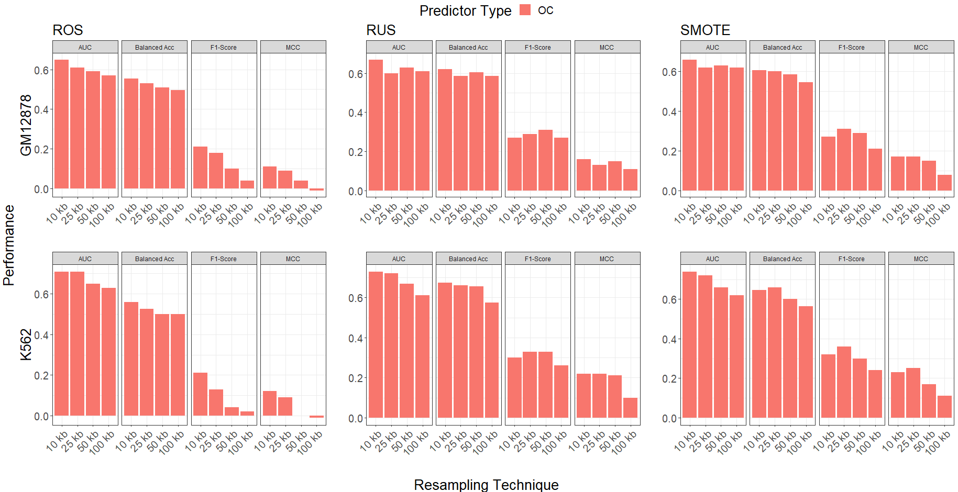
Data Re-Sampling Improves Model Performance
Using balanced metrics shows improvement in model performance after creating balanced classes
Conventional metrics remain invariant
Performances appear to degrade as resolution increases

Slide 33
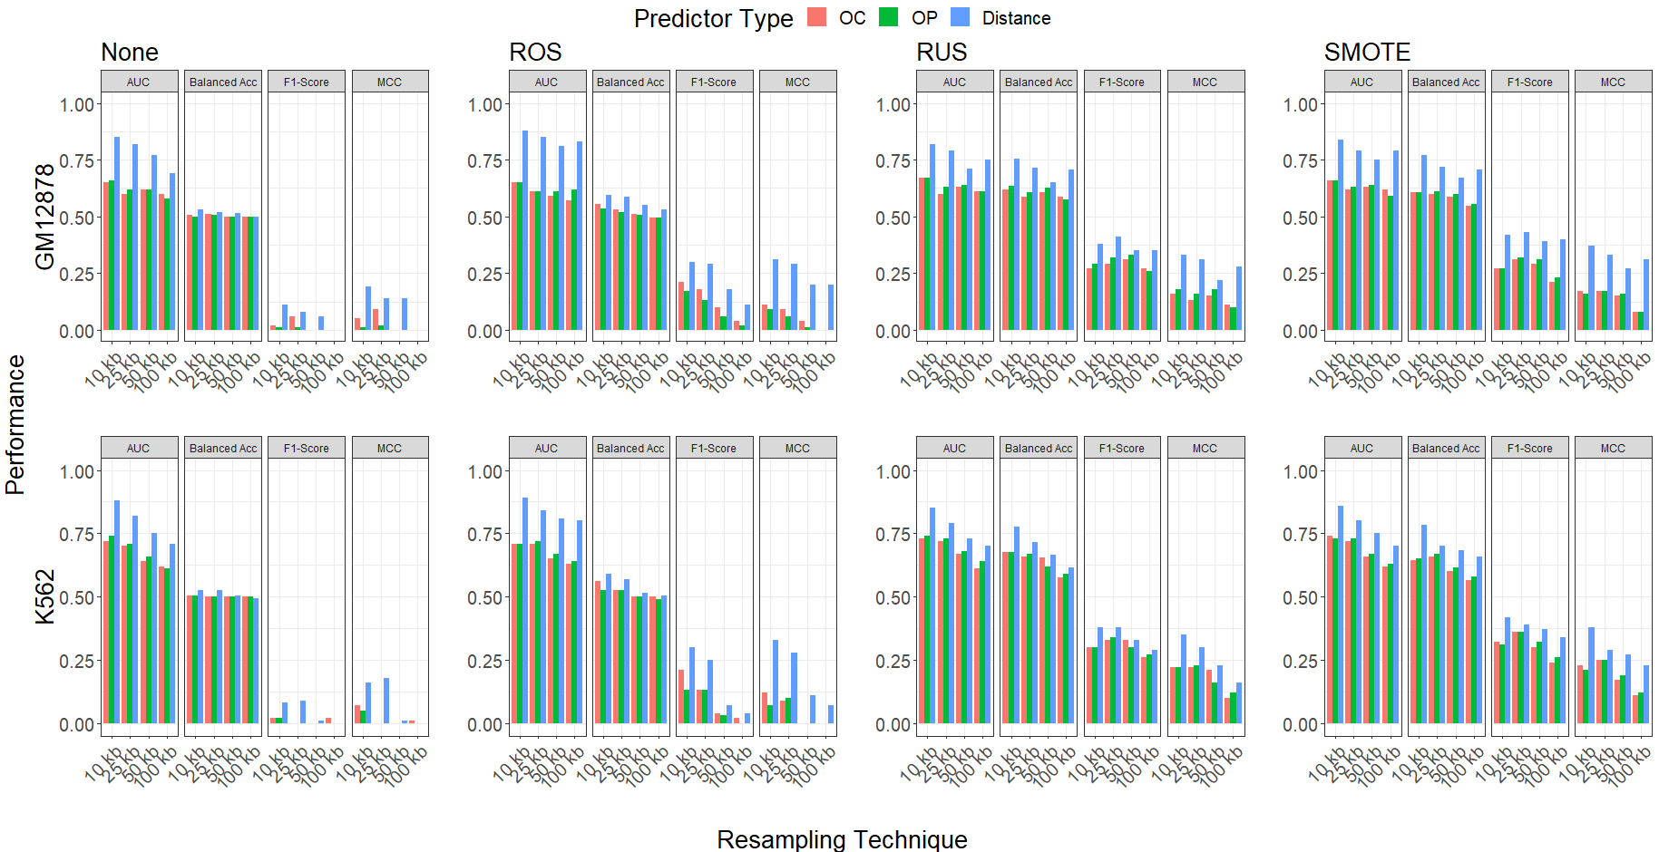
Using Distance-Type Predictors Further Improves Model Performance
Models with distance type predictors outperform models with other predictor types
Performances continue to degrade as resolution increases
Results are consistent across resampling technique, data resolution, and cell line

Slide 34
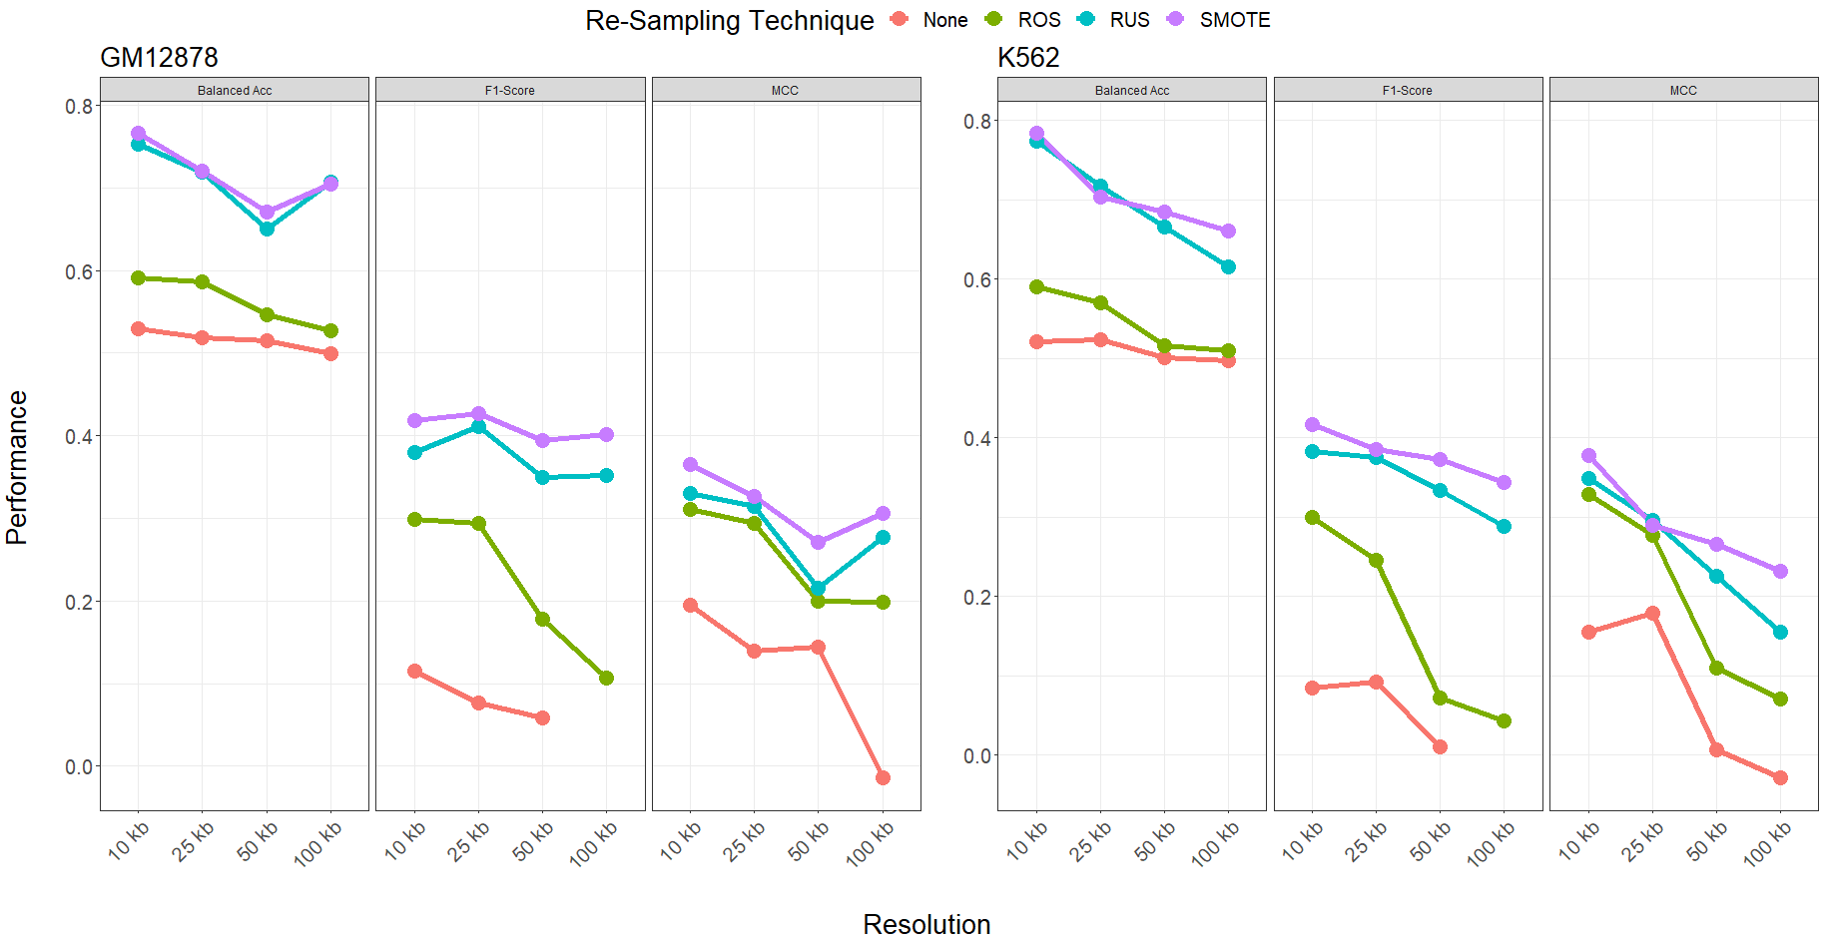
Models Implemented on SMOTE Re-Sampled Data with Distance-Type Predictors Performed Best Among ALL Ensemble Systems

Slide 35
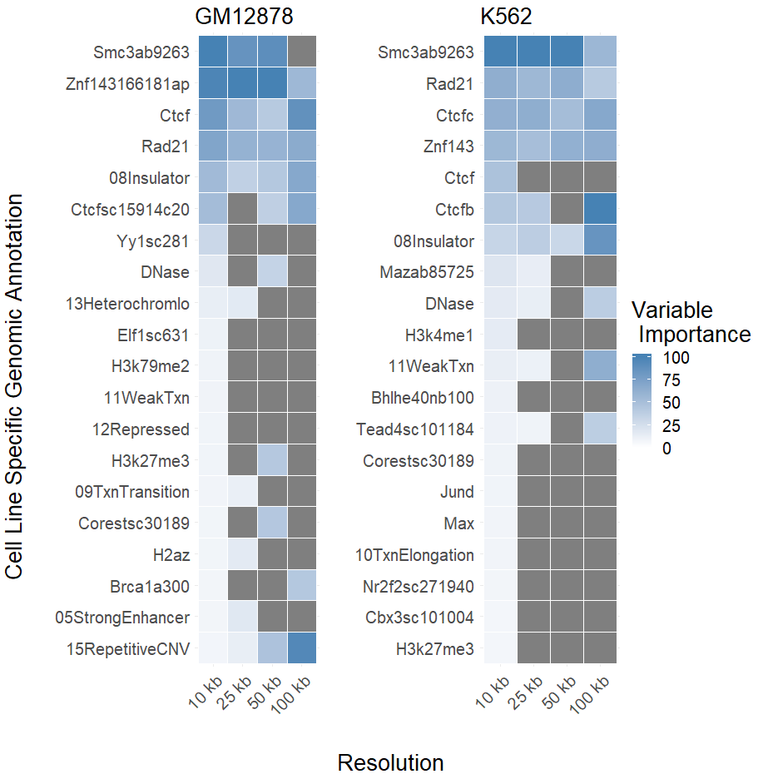
Variable Importances Confirm Biological Functionality of Known Genomic Annotations
https://www.pnas.org/content/pnas/112/47/E6456.full.pdf

